Slide 1
Welcome to Senior Parent Night
Class of 2022
Sponsor: Tanya Rae
…Inspired by World Class

Slide 2
We want you…. to be involved!
Queremos que usted se involucre!
We would like to discuss some of the requirements that your son or daughter must fulfill in order to participate in ANY senior activity.
Quisiéramos comentar con ustedes unos de los requerimientos que su hijo/a debe de completar antes de poder participar en cualquier actividad para los Seniors.
…Inspired by World Class

Slide 3
Permission to participate in any senior activity will be denied or revoked for any of the following reasons:
Permiso para participar en los actividades pueden ser revocadas por cualquiera de los razones que siguen:
…Inspired by World Class

Slide 4
Attendance
Asistencia
The student may not have more than 5 unexcused absences in any semester class or 10 unexcused absences in any annual class.
The student must not have more than 20 tardies to school.
If you have an unexcused absence on the day of a senior event, you will not be able to attend the following senior event. No exceptions!
El estudiante no puede tener mas de 5 ausencias sin excusa en ninguna clase semestral o 10 ausencias sin excusa en una clase anual.
El estudiante no puede tener mas de 20 días tarde a la escuela.
Si el estuduante tiene una ausencia sin excusa el día de una actividad de Senior, no podrán asistir el siguiente!
…Inspired by World Class

Slide 5
Finances
Finanzas
All school debts must be paid before buying an event ticket.
This includes library fees, class fees, lost textbooks, and laptops.
Todas las deudas tienen que estar pagadas antes que compras un ticket.
Esto incluye las deudas a la biblioteca, deudas de las clases, y libros perdidos.
STOP Financial System
http//fl-dade.stopforschools.com
username: student id number
password: DOB (mm/dd/yyyy)
…Inspired by World Class

Slide 6
Community Service
Horas
Comunitarias
All students must have 100 hours of community service submitted and entered into the school’s database by October 31 to be an academy completer and qualify for Bright Futures.
For questions, please speak to your child’s lead teacher.
Todos los estudiantes deben tener 100 horas comunitarias antes del 31 de octubre para completar los requisitos de su academia y para calificar a Bright Futures.
Si usted tiene cualquier pregunta, por favor comuniquese con la maestra de la academia.
…Inspired by World Class

Slide 7
Student Success Center
Centro de exito estudiantil
Students must not have been on Student Success Center Assignment and/or indoor suspension (SCSI) for 5 or more days.
Estudiantes no pueden tener más de 5 días de suspensión afuera del colegio o 5 días de Student Success Center Assignment.
…Inspired by World Class

Slide 8
G.P.A.
G.P.A.
Students must have a minimum 2.0 GPA to participate in senior events.
Estudiantes deben de tener un minimo de 2.0 GPA para participar en los eventos de los seniors.
…Inspired by World Class

Slide 9
Misconduct
Mala Conducta
Any Senior who is found in possession of any illegal substance or whose behavior is disruptive at a Ferguson-sponsored event, as deemed by an administrator, will be automatically excluded from all future senior activities.
Cualquier Senior que se encuentre en posesión de cualquier sustancia ilegal o cuyo comportamiento es perturbador en un evento patrocinado por John A. Ferguson, según se considere por un administrador, será automáticamente excluido de todas las actividades de alto nivel en el futuro.
…Inspired by World Class

Slide 10
Other Requirements
All seniors must sell at least two Edda’s Cakes by October 18th.
This is to alleviate the costs of all other senior activities.
Example: Buses for GradBash are almost $3000 each!!
Incentives
Sell 5 – 1 Extra Graduation ticket
Sell 10 – 1 Extra Graduation ticket
Sell 15 – 1 Extra Graduation ticket
Sell 25 – 1 Senior Picnic Ticket
Sell 35 – 1 Senior Breakfast Ticket
Sell 50 – 1 Prom ticket
…Inspired by World Class

Slide 11
Otros requisitos
Todos los estudiantes deben de vender por lo menos dos tortas de Edda’s antes del 18 de Octubre.
Esto es para aliviar los costos de el resto de las actividades de su hijo
Por ejemplo: ¡los autobuses para el viaje de los Seniors son casi $3000 por cada uno!!
Incentivos
Vende 5 – 1 Ticket extra de graduacion
Vende 10 – 1 Ticket extra de graduacion
Vende 15 – 1 Ticket extra de graduacion
Vende 25 – Senior Picnic Gratis
Vende 35 – Senior Breakfast Gratis
Vende 50 – Prom Gratis
…Inspired by World Class

Slide 12
Special Note
*We do not give extra graduation tickets at the end of the year; this will be your only chance to get any additional tickets for your family.
* No damos entradas adicionales de graduación al final del año, este será su única oportunidad de conseguir boletos adicionales para su familia.
…Inspired by World Class

Slide 13
Important Dates
Homecoming Game- October 14th
Homecoming- October 16th
Senior Picnic- November 12th
Senior Breakfast- March 4th
Grad Bash- TBA
Prom- May 14th
Graduation- TBA
Important College Dates to Remember:
October to January - College Applications Due
After January 1 – Students eligible to apply for Financial Aid
…Inspired by World Class

Slide 14
Fechas Importantes
Octubre 14: Juego de Homecoming
Octubre 16: Baile de Bienvenida
Noviembre 12: Senior Picnic
Marzo 4: Senior Desayuno
TBA: Viaje de fin de ano
Mayo 14: Fiesta de Prom
TBA : Graduación
Important College Dates to Remember:
De Octubre a Enero – Aplicaciones para la universidad tienen que ser enviadas
Después de Enero 1 – Estudiantes son elegible para ayuda financiera
…Inspired by World Class

Slide 15
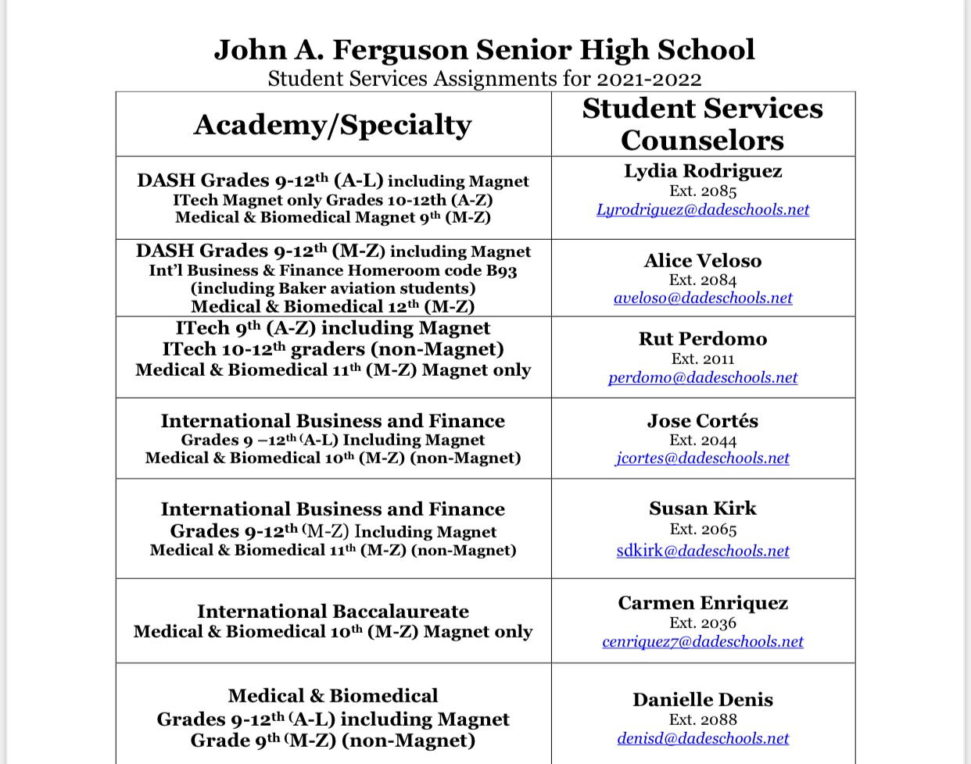
School Counselors
…inspired by World Class

Slide 16
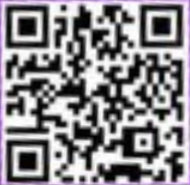
Cap Advisor
Scan Me and join the CAP Band!
Aitana Aponte
aaponte@dadeschools.net
Join the CAP band communication app (Scan the QR code on the right.)
…Inspired by World Class

Slide 17
Please scan the QR code on the left to join SCOIR!
…Inspired by World Class

Slide 18
College Month! Please take a moment and read the flyer.
…Inspired by World Class

Slide 19
Yearbook Online Sales
This year we will be selling yearbooks online. All you have to do is log on to www.yearbookordercenter.com, type in the order number 498, and look for your child. If your child does not appear on the student list then type in their information. You may pay with a credit card or check.
We will have sales on campus as well. We accept cash, checks and OSP (a message will be sent once Yearbook sales are on OSP).
Buy today only $70.00!
Do not wait until the end of the year to purchase a yearbook. Only the amount of books sold during the year are ordered. We always sell out!
Any questions please email Mr. Lage (lagegabrielj@dadeschools.net)
Senior Pictures
Senior Pictures must be taken by January 14, 2022.
There will be a list of students who have not taken their pictures yet located in building 10. Please contact FoxMar directly to make an appt.
…Inspired by World Class

Slide 20
Ventas del anuario via internet
Este año estaremos vendiendo anuarios en línea. Todo lo que tienes que hacer es iniciar sesión en www.yearbookordercenter.com, escriba el número de orden 498 y busque a su hijo. Si su hijo no aparece en la lista de estudiantes, escriba su información. Usted puede pagar con una tarjeta de crédito o cheque.
También tendremos ventas en el campus. Aceptamos dinero en efectivo o cheques o OSP.
Compre hoy por solo $70.00!
No espere hasta el final del año para comprar un anuario. Sólo se ordena la cantidad de libros vendidos durante el año.
Cualquier pregunta por favor envíe un correo electrónico al Mr. Lage
Senior Pictures
Senior Pictures se deben tomar antes del 14de enero de 2021.
Habrá una lista de estudiantes que no han tomado sus fotografías todavía localizadas en el edificio 10. Por favor visite la feria de recursos para hacer una cita.
…Inspired by World Class

Slide 21
…Inspired by World Class

Slide 22
School and Activities Website
A great way to receive information from the school is the school and Activities website:
www.fergusonhs.org
http://ferguson.dadeschools.net/Students/Activities/index.html
Una gran forma de obtener informacion de la escuela es el sitio web de la escuela y las actividades.
www.fergusonhs.org
http://ferguson.dadeschools.net/Students/Activities/index.html
…Inspired by World Class

Slide 23
School Social Media
School
Twitter: @fergusonshs
Instagram: @fergusonfalcons
…Inspired by World Class

Slide 24
Senior Social Media
Instagram: @jafalcons2022
Band:
Download and type the link https://band.us/n/aca86fCcY234J
…Inspired by World Class

Slide 25
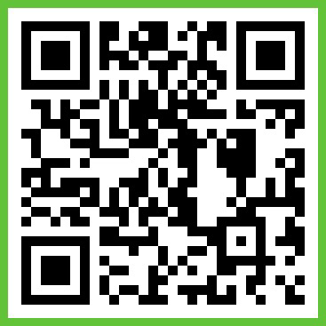
Join Senior Parent Band
Download and type the link
https://band.us/n/aca86fCcY234J
in your browser.
You can also scan the QR code on the right:
SCAN ME!!

Slide 27
Senior Picnic
Senior Picnic is $30 but you can pay $25 if you join the Class of 2020 Band, Parent Class of 2020 Band, and PTSA Band! (get $5 off)
SENIOR SHIRT
PRICE: $15
“A” World Class School!

Slide 28
OSP Instructions
1. Log into your student portal
2. Click on apps and services
3. Search for the OSP app and click on it
4. Once on the website hover over secondary school
5. Find John A. Ferguson Senior high and click on it
6. Find and click on 21-22 Class of 2022 T-shirts
7. Follow instructions to finalize payment
…Inspired by World Class

Slide 30
Senior Picnic Special Price
To earn the $25.00 price for Senior Picnic, by September 30 you must join the:
Senior Band
Senior Parent Band
Falcon Instagram
Falcon Athletic Instagram
Cap Band
SCOIR App
The only proof accepted will be a screen shot of each band with date showing.
…Inspired by World Class

Slide 31
Up Next
Fill out the google survey to get credit for attending this senior parent night.
Have your child report to the Activities Office (room 50) to pick up a letter with all of their graduation information.
Remember, you can purchase shirts and sweaters from the Senior Class and SGA via OSP. You can also join PTSA.
You can also order yearbooks from the yearbook website.
…Inspired by World Class

Slide 32
If you need to contact me...
Si usted necesita contactarno ...
Senior Class Sponsor and Activities Director
Tanya Rae
stingrae@dadeschools.net
305-408-2700 ext. 2024
…Inspired by World Class

Slide 33
Attendance Link
Use this link or the QR Code: https://docs.google.com/forms/d/e/1FAIpQLSfzF50PvU9WsttkCns9_mykol1GyY6XBnXHwUcnuXbvSK9N9g/viewform THANK YOU SO MUCH FOR ATTENDING!
…Inspired by World Class

Slide 34
Q & A
…Inspired by World Class

Slide 35
…Inspired by World Class

